Slide 1
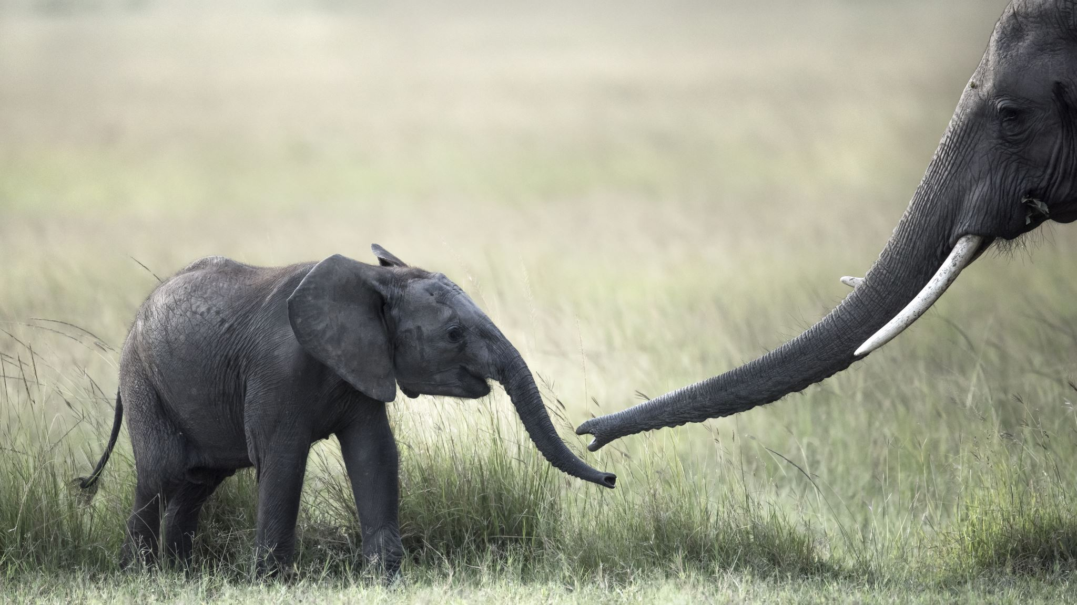
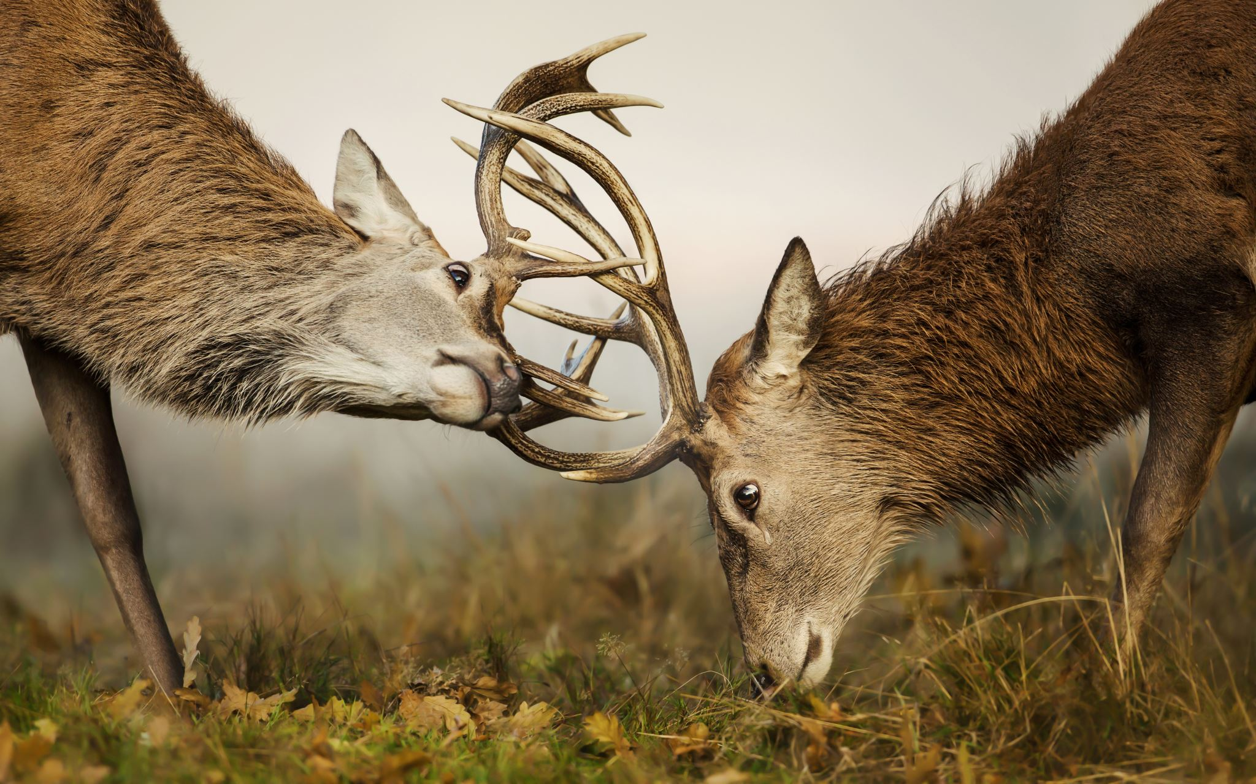
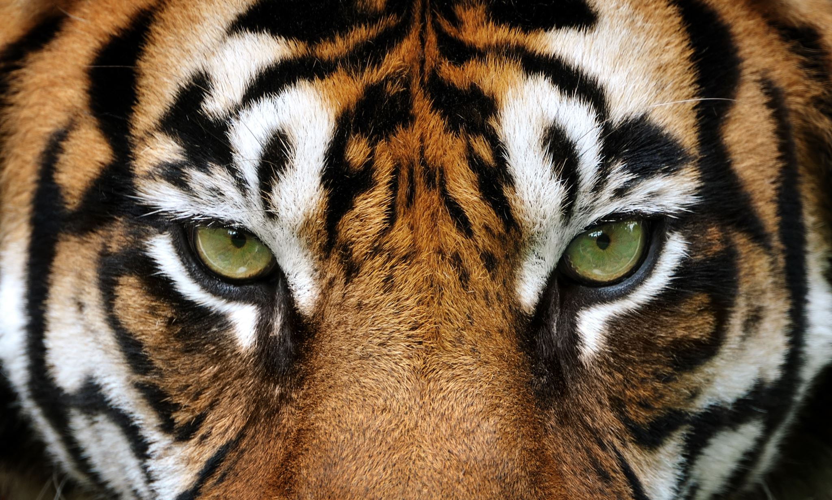
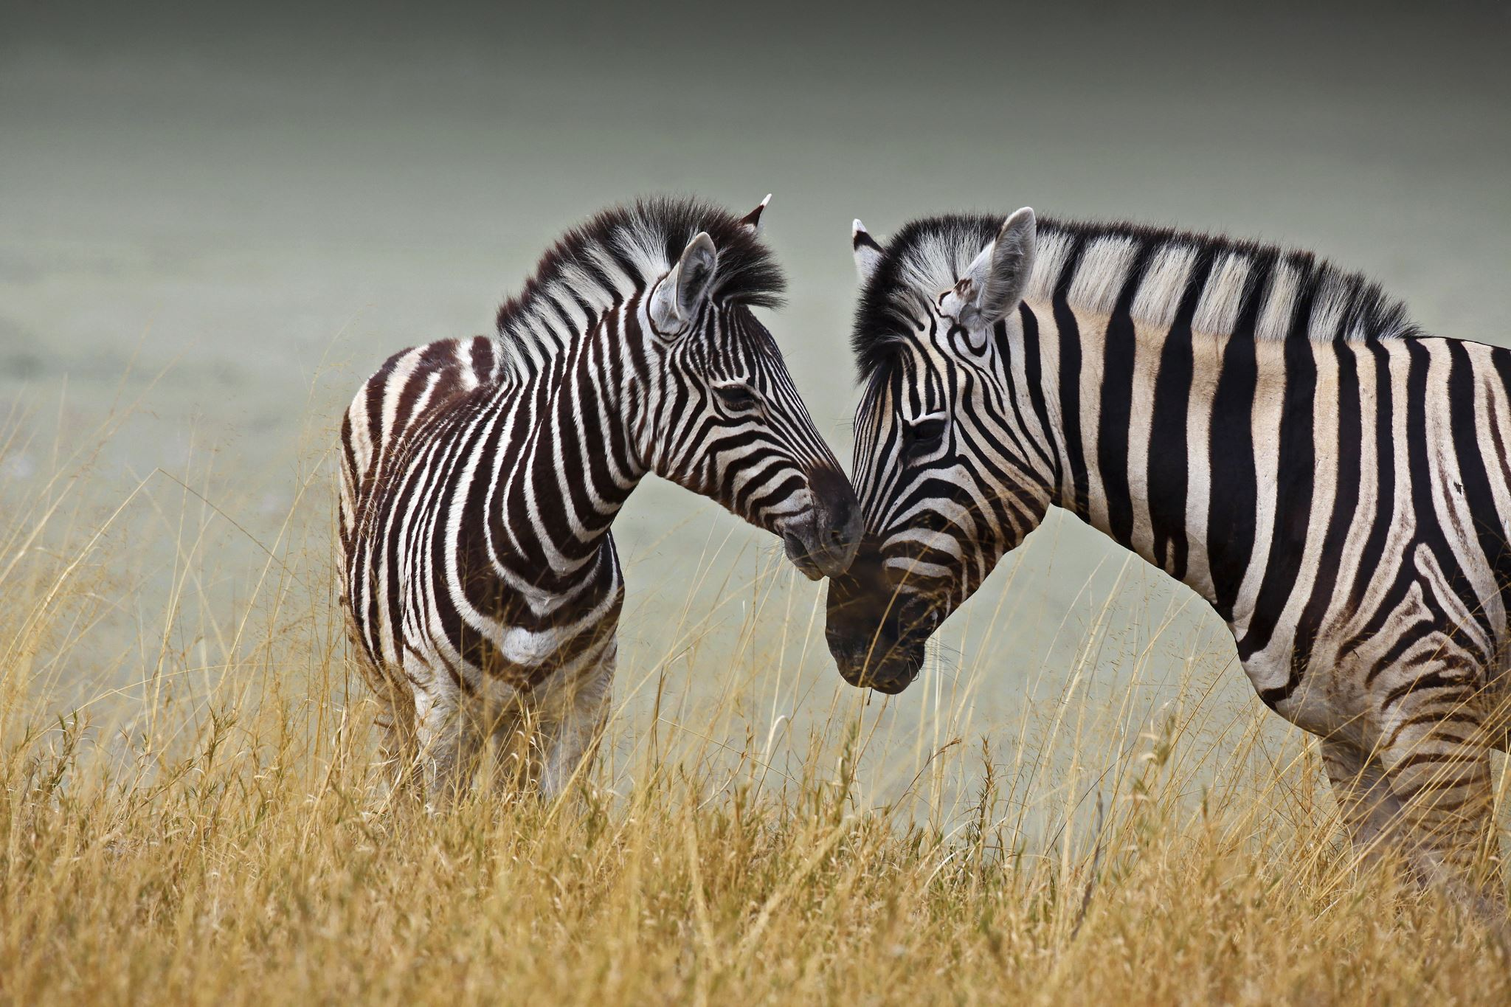
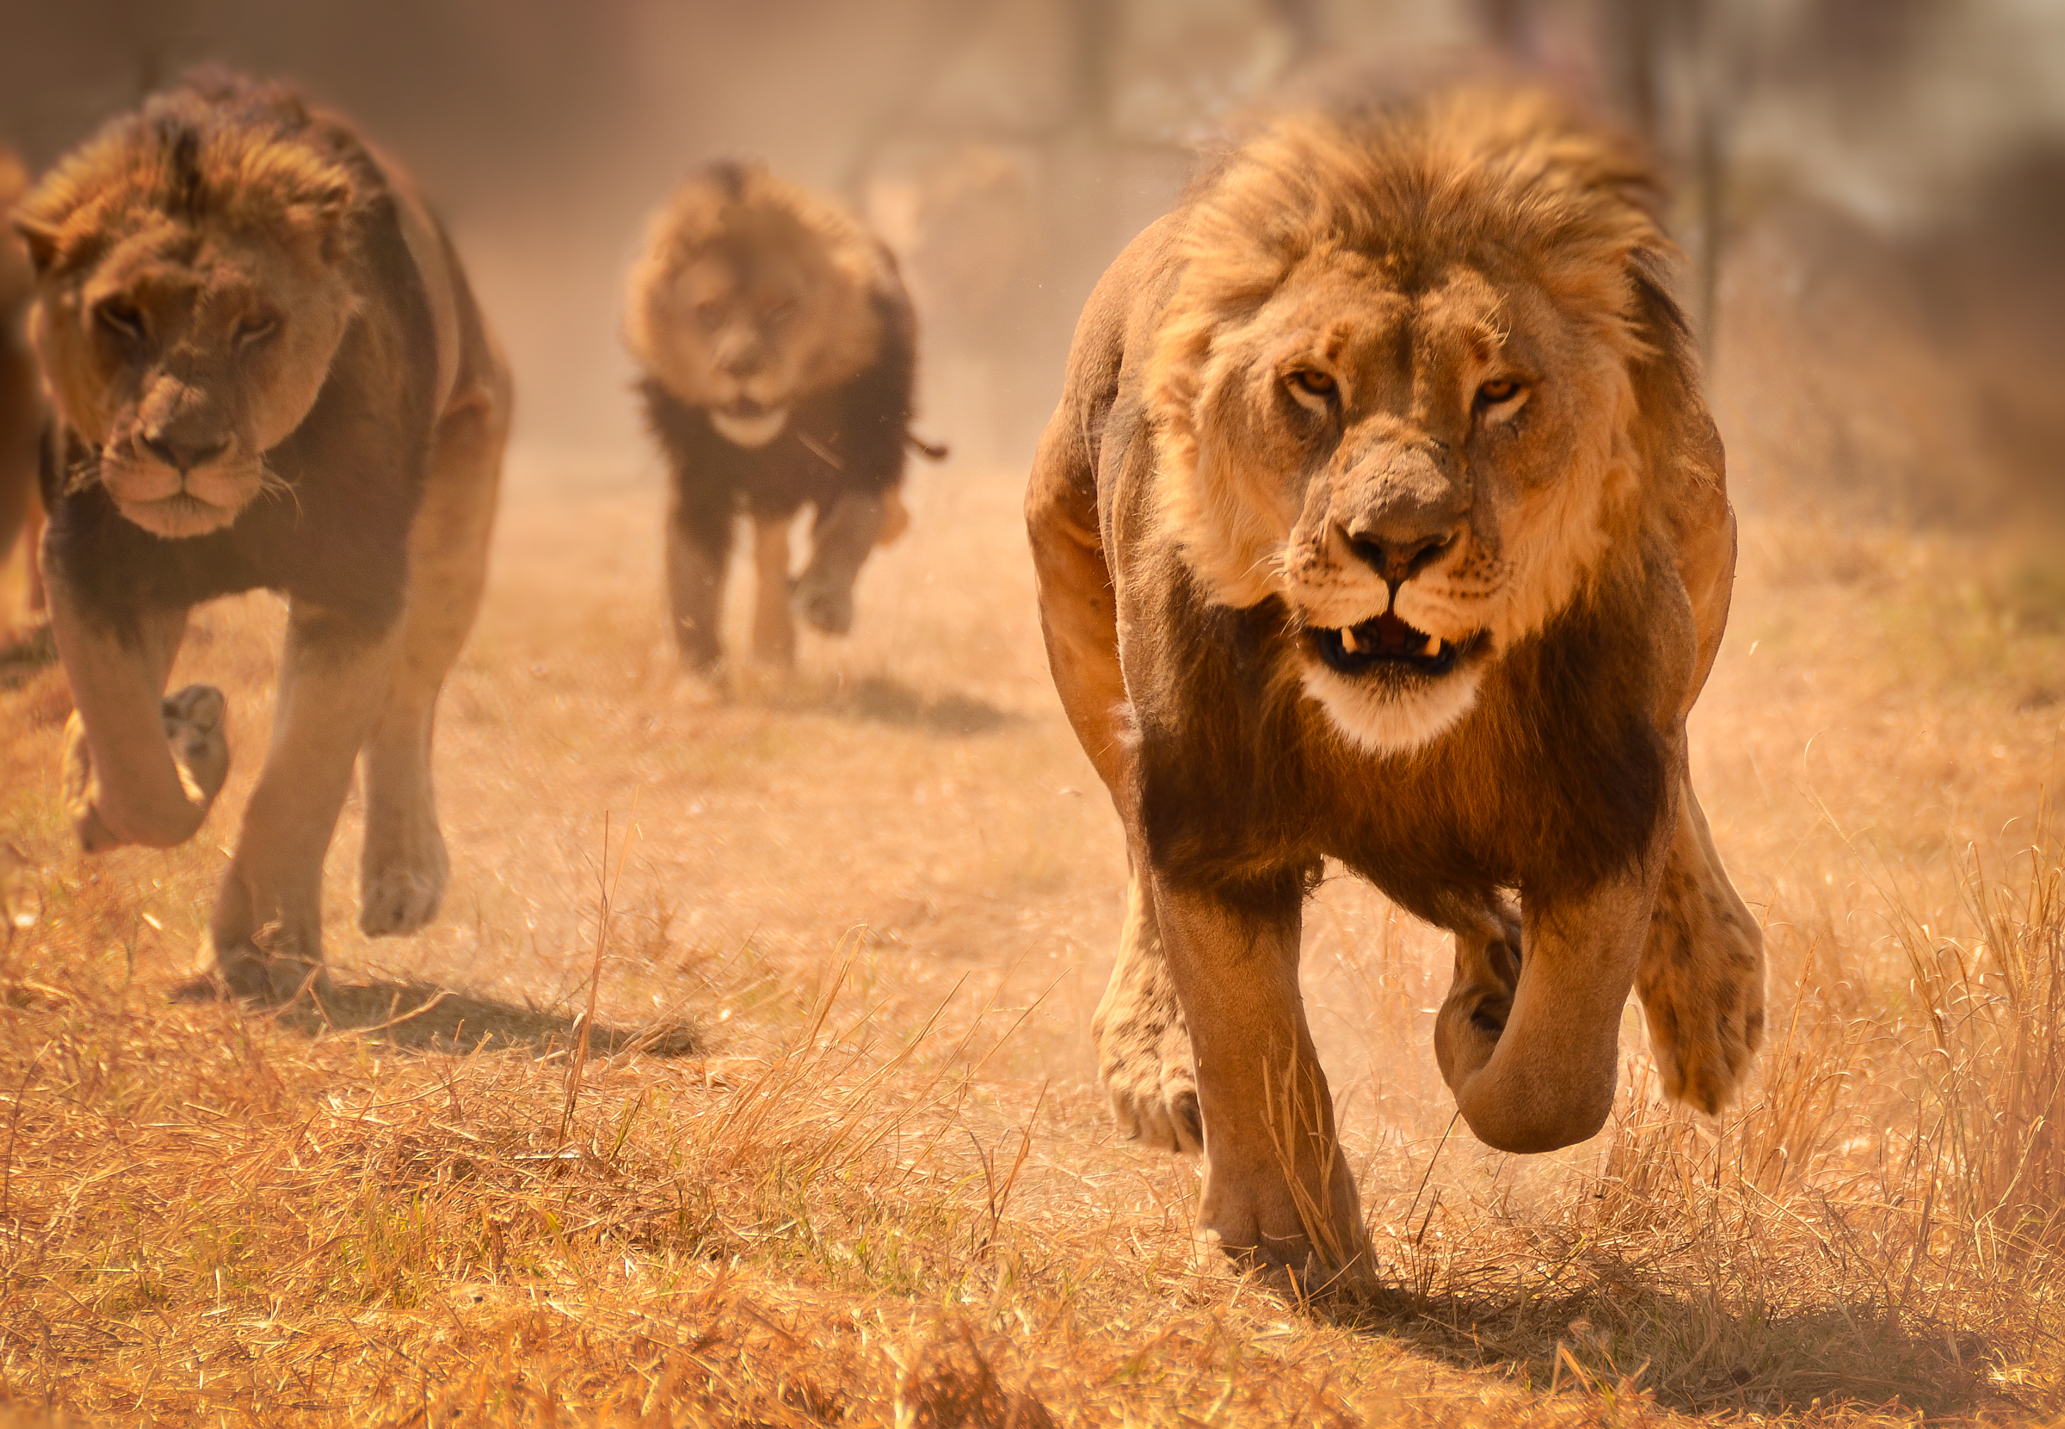
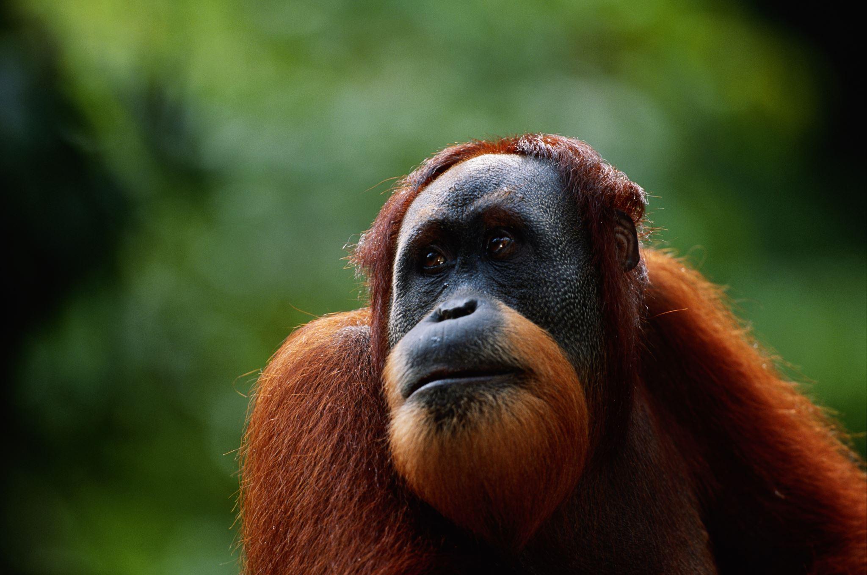

iWildCam 2022
By Yarden Dahan

Slide 2
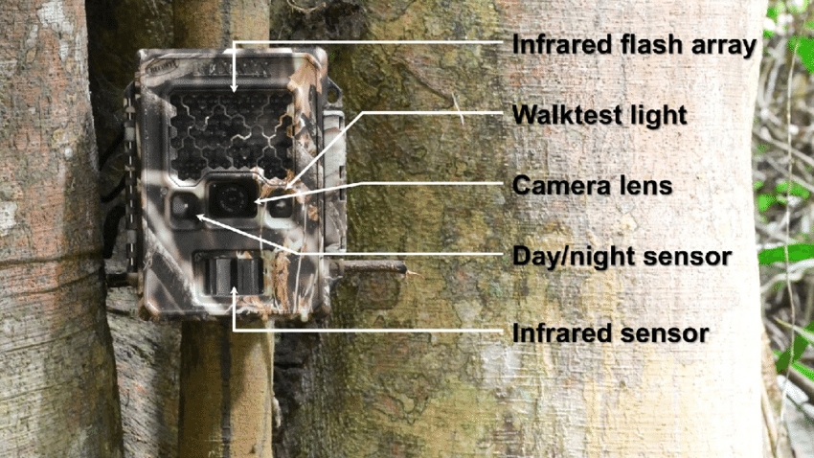
Competition Overview
This competition aims to identify how many animals appear in a sequence of Camera Trap images.
A Camera Trap is triggered when it detects motion.
This task is solved by algorithms that can also be applied to videos (videos consist of sequences of images ,frames).

Slide 3
Solution process:
Object Detection Model
Mega Detector model
YOLOv5
Multiple Object Tracking
Counting heuristic
Deep-Sort-Tracker
Centroid-Tracker
Detections with Conf > 0.95
Detections with Conf > 0.9

Slide 4
Step 1: Object Detection Model
Model that Microsoft trained - called "MegaDetector" - to detect animals, people, and vehicles in camera trap images. It does not identify animals to the species level, it just finds them.
And this is exactly the need for this competition. Compared to YOLOv5 which also categorizes the animals into species. That's why we chose this model (Mega detector).
In an investigation of the competition data, I discovered that we are completely spared this step - we already receive the Mega detector model identifications.
Object Detection Model
Mega Detector model
YOLOv5
Multiple Object Tracking
Counting heuristic
Deep-Sort-Tracker
Centroid-Tracker
Detections with Conf > 0.95
Detections with Conf > 0.9

Slide 5
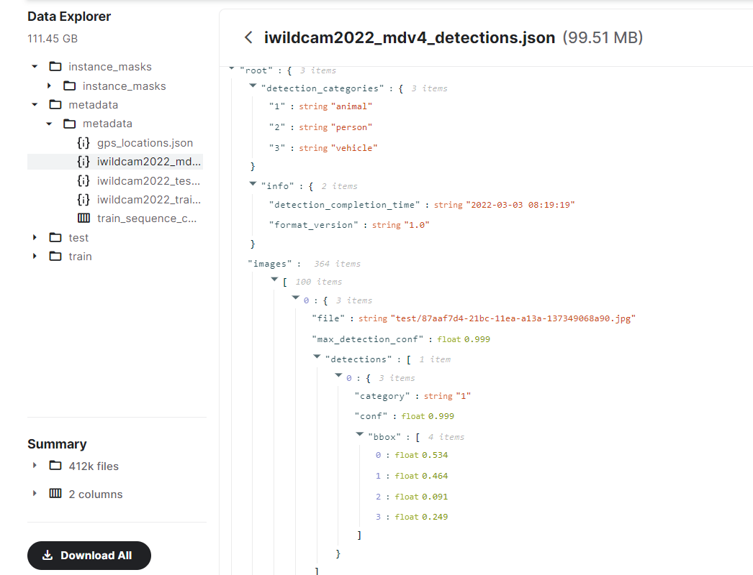
Step 1: Mega Detector’s Detections
The model identified an animal, at a confidence level of 0.999, in the location indicated under bbox in the image.

Slide 6
Step 2: Counting Heuristic
Using this method, we count the number of identifications in each frame with a confidence level greater than 0.95.
We choose the frame in the sequence that has the highest number of identifications.
The maximum number will be the total number of animals in the whole sequence.
It is useful to use this method because if several animals pass by together, it may be that the camera trap captured them all in one frame.
The naive method simplifies the competition and makes it easier to solve.
This heuristic was used by the winners of this competition last year.
Object Detection Model
Mega Detector model
YOLOv5
Multiple Object Tracking
Counting heuristic
Deep-Sort-Tracker
Centroid-Tracker
Detections with Conf > 0.95
Detections with Conf > 0.9

Slide 7
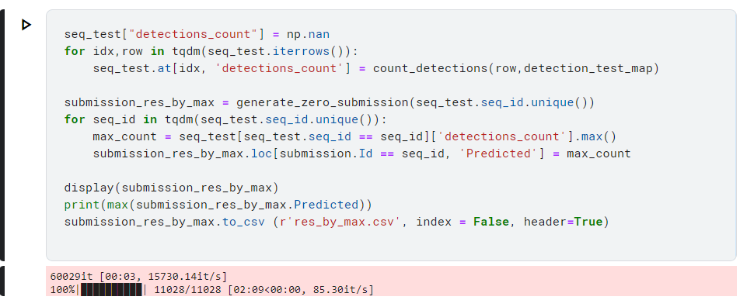
Step 2: Counting Heuristic Implementation
Important note - in order to run on the data, you must run on a table where the sequence ID is unique and does not repeat itself, thus avoiding unnecessary repetitions of the loop, and the performance will be faster.

Slide 8
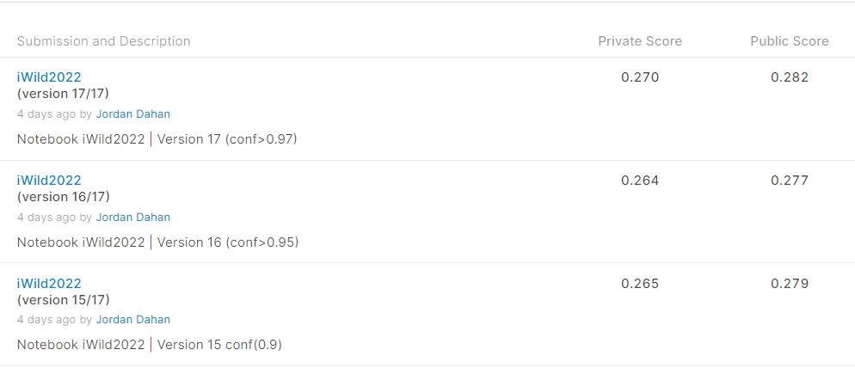
Step 2: Counting Heuristic Results
Important note - As you can see - when the solution is to count the number of maximum detections of the MegaDetector model, the best results come when extracting the detections with conf> 0.95

Slide 9
Step 2: Multiple Object Tracking
Object tracking is a deep learning process where the algorithm tracks the movement of an object. In other words, it is the task of estimating or predicting the positions and other relevant information of moving objects in a video.
Here’s a quick overview of the steps:
Object detection, where the algorithm classifies and detects the object by creating a bounding box around it.
Assigning unique identification for each object (ID).
Tracking the detected object as it moves through frames while storing the relevant information.
SOT/MOT:
In SOT, the bounding box of the target object is defined in the first frame. The goal of the algorithm is then to locate the same object in the rest of the frames. (Not our case).
In MOT, the tracking algorithm determines the number of objects in each frame, following that it keeps track of each object’s identity from one frame to the next frame until they leave the frame. (Our case).
Object Detection Model
Mega Detector model
YOLOv5
Multiple Object Tracking
Counting heuristic
Deep-Sort-Tracker
Centroid-Tracker
Detections with Conf > 0.95
Detections with Conf > 0.9
Notes:
Video tracking is widely used in traffic monitoring, self-driving cars, and security because it can process real-time footage.
* Single Object Tracking(SOT) - SOT belongs to the category of detection-free tracking because one has to manually provide the first bounding box to the tracker. This means that Single Object Trackers should be able to track whatever object they are given, even an object on which no available classification model was trained.
* Multiple Object Tracking(MOT): it aims to track objects of multiple classes as we see in self-driving cars.

Slide 10
Step 3: Centroid-Tracker
Object Detection Model
DEEP SORT: DEEP SORT is one of the most widely used tracking algorithms, and it is a very effective object tracking algorithm since it uses deep learning techniques. it works with YOLO object detection and uses Kalman filters for its tracker.
Centroid Tracking algorithm: The centroid Tracking algorithm is a combination of multiple-step processes. It uses a simple calculation to track the point using euclidean distance.
Mega Detector model
YOLOv5
Multiple Object Tracking
Counting heuristic
Deep-Sort-Tracker
Centroid-Tracker
Detections with Conf > 0.95
Detections with Conf > 0.9

Slide 11
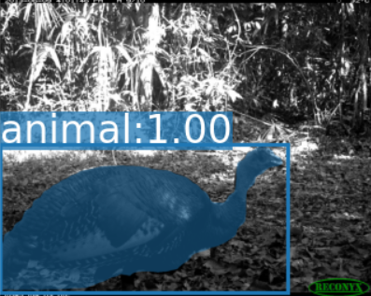
How Centroid-Tracker Work?!
Step 1:
Calculate the Centroid of detected objects using the bounding box coordinates.
(x1,y2)
(x2,y2)
(cx, cy)
(x1,y1)
(x2,y1)
Center_x = (x1+x2) / 2
Center_y = (y1+y2)/2

Slide 12
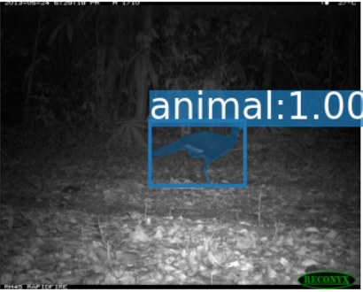
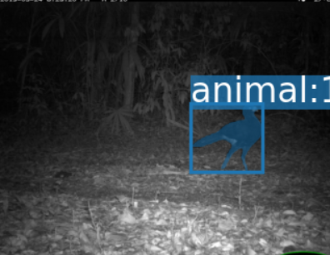
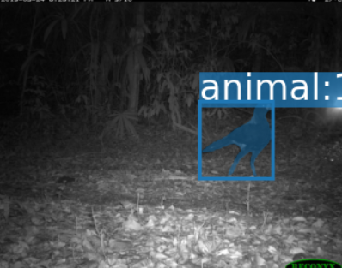
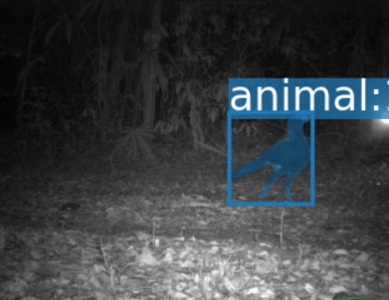
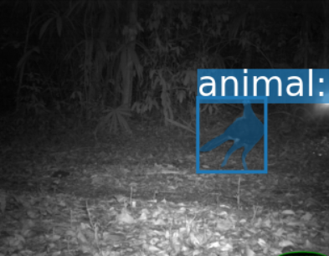
How Centroid-Tracker Work?!
Step 2:
For every ongoing frame, it does the same; it computes the centroid by using the coordinates of the bounding box and assigns an id to every bounding box it detects.

Slide 13
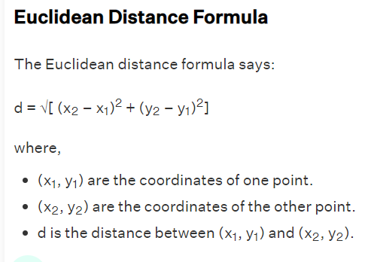
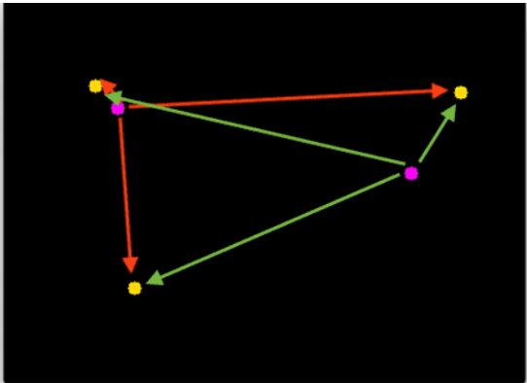
How Centroid-Tracker Work?!
Step 3:
Finally, it computes the Euclidean distance between every pair of centroids possible.

Slide 14
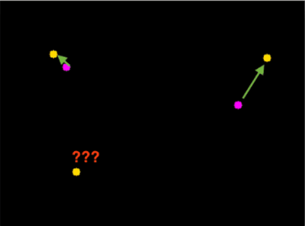
How Centroid-Tracker Work?!
Step 4:
We assume that the same object will be moved the minimum distance compared to other centroids, which means the two pairs of centroids having minimum distance in subsequent frames are considered to be the same object.
Min(d1,d2,d3,d4,…)

Slide 15
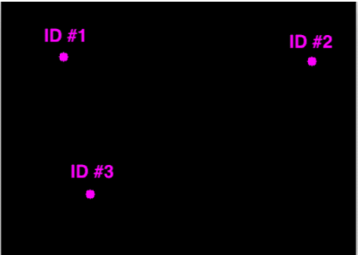
How Centroid-Tracker Work?!
Min(d1,d2,d3,d4,…)
Step 5:
assign the IDs to the moved centroid that will indicate the same object.
AssignID()

Slide 16
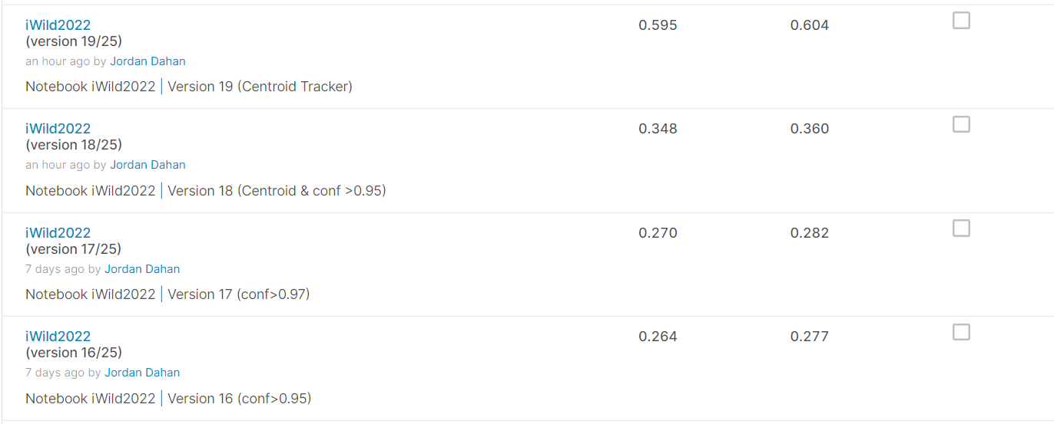
Centroid Tracker results
Step 2: Centroid-Tracker
Important note - As you can see - when the solution is to count the number of maximum detections of the MegaDetector model, the best results come when extracting the detections with conf> 0.95

Slide 17
THE END!

